Slide 1
Autonomous Energy Grid optimization
Steven Low
NREL, September 2017
Notes:
Caltech power system research:
Network architecture
June 2012: Caltech IST Advisory Board Meeting, Palo Alto (Mathieu Desbrun)
Oct 2012: GridWise Council Meeting (Paul, DeMartini, Ron Meltzer)
Dec 2012: Workshop on smart grid, University of Florida, Gainsville, FL (Sean Meyn)
Dec 2012: SCE Tech Advisory Board meeting, Westminster, CA
Dec 2012: Resnick Grid 2020 Seminar Panel, Caltech (Paul, DeMartini)
March 2013: Resnick Advisory Council, Caltech
April 2013: BCG, San Francisco, CA
May 21, 2013: Honeywell visit, Caltech (Rhonda Germany – Vice President, Chief Strategy & Marketing Officer, and team)
June 4, 2013: Electric Power Control Centers (EPCC) Workshop (Dejan Sobajic <dsobajic@gridengineering.com>)
June 25, 2013: FERC Technical Conference on Increasing Real-Time and Day-Ahead Market Efficiency through Improved Software (Richard O’Neill)
Branch Flow Model: relaxations, convexification, computation
May 24, 2012: Optimization and Control for Smart Grids, 32nd CNLS Annual Conference, Santa Fe, NM (Misha Chertkov)
June 11, 2012: Greenmetrics Workshop, London, UK (Adam Wierman)
June 26, 2012: FERC Conference, Washington D.C. (Dick O’Neil)
July 31, 2012: Energy Day, Chinese University of Hong Kong (Minghua Chen)
Aug 2, 2012: HK University of Science & Technology (Vince Lau, Roger)
Aug 3, 2012: Hong Kong University, EE Dept, HK (Victor Li)
Aug 6, 2012: Tsinghua University, Institute of Theoretical Computer Science, Beijing, China (Raymond Yeung)
Aug 17, 2012: Zhejiang University, EE Dept, Hang Zhou, China (Jiming Chen)
Aug 20, 2012: Shanghai Jiaotong University, EE Dept, Shanghai, China (Xinbing Wang)
Sept 5, 2012: U Texas A&M, Dept of ECE, Fishbowl Seminar Series (Srinivas Shakkottai)
Sept 2012: Swinburne University, Australia (Lachlan Andrew)
Nov 15, 2012: Distinguished Speaker, Northeast University, Boston MA (Edmund Yeh)
Equivalence of Branch Flow and Bus Injection Models
Oct 5, 2012: 50th Annual Allerton Conference (Dominguez-Garcia, Alejandro)
Exact relaxation for radial networks
Nov 6, 2012: IEEE SmartGridComm Conference (Tainan, Taiwan)
Jan 25, 2013: SUNY Buffalo, EE Dept (Dimitri Pados)
Feb 20, 2013: DIMACS workshop, Rutgers University, NJ (Dan Bienstock, SL)
March 20, 2013: UCLA SMERC Lecture (Rajit Gadh)
March 21, 2013: Systems and optimization aspects of smart grid challenges 2013, U Arizona, Tucson
March 28, 2013: Michigan, Ann Arbor (Ian Hiskens)
June 5, 2013: Electric Power Control Center (EPCC) Workshop (Dejan Sobajic, NYISO)
June 19, 2013: ACC Smart Grid Tutorial (Dennice Gayme, Ufuk Topcu)
July 4, 2013: 2nd International Workshop on Mathematical Issues in Information Sciences, Xi’an, China (Tom Luo)
August 25-30, 2013: IREP Symposium-Bulk Power System Dynamics and Control -IX (IREP), Rethymnon, Greece
Smart grid and OPF
Sept 26, 2013: Science & Technology Innovators Lecture Series, DTC, U of Minnesota, Minneapolis, MN (Giannakis)
November 29, 2013: University of Waterloo, Canadan (S. Keshav)
Feb 12, 2014: University of Washington, Seattle (Daniel Kerschen)
March 25-28, 2014: Short course, Zhejiang University [with Vincent Lau, HKUST] (Jiming Chen, Prof Zhang)
Tutorial: Convex relaxation of OPF
April 23, 2014: RTE-IBM workshop on “Semidefinite Programming for Optimal Power Flow Problems”, Dublin, Ireland (Patrick Panciatici, RTE)
June 19-23, 2014: Lehigh University, PA (Nader Motee)
August 20, 2014: PSCC invited session, Wroclaw, Poland (Patrick Panciatici)
Oct 15, 2014: LCCC Workshop on Dynamics and Control in Networks, Lund, Sweden (Anders Rantzer)
Oct 27, 2014: IEEE Trans on Control of Network Systems Symposium, Boston (Yannis Paschilidis)
Control and optimization of networked DER
May 21, 2013: Honeywell visit, Caltech (Rhonda Germany – Vice President, Chief Strategy & Marketing Officer, and team)
June 4, 2013: Electric Power Control Centers (EPCC) Workshop (Dejan Sobajic <dsobajic@gridengineering.com>)
June 25, 2013: FERC Technical Conference on Increasing Real-Time and Day-Ahead Market Efficiency through Improved Software (Richard O’Neill)
Feb 2015: Caltech lunch bunch
Sept 2015: Energy Colloquium, Skoltech, Moscow, Russia (Junusz Bialek)
Nov 2015: University of Toronto, ECE Dept, Distinguished Lecture Series (Joshua Taylor)
July 2016: GE Monthly Tech Talk, Redmond, WA (Kwok Cheung)
Sept 2017: NREL Workshop on Autonomous Energy Grid: optimization (Ben Kroposki, Emiliano Dall’Anese)

Slide 2
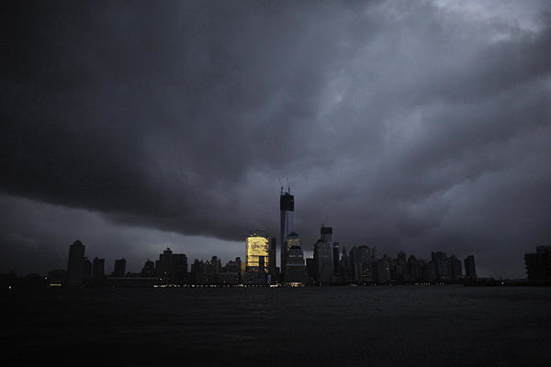
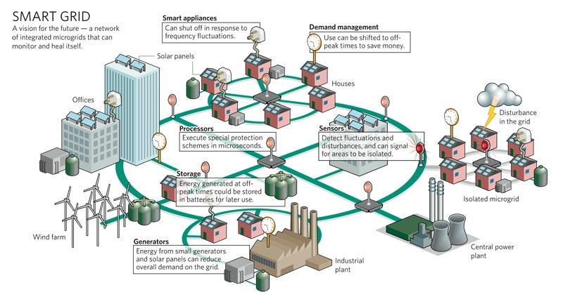
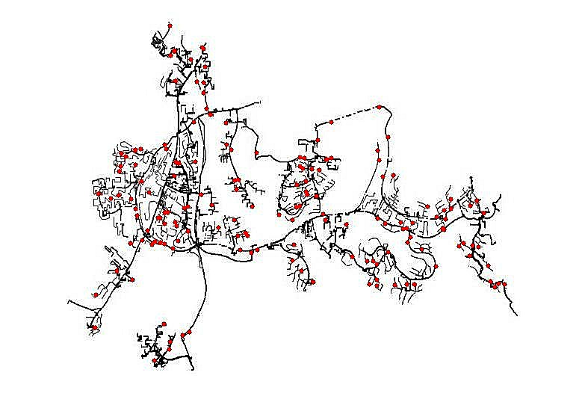
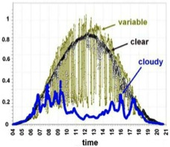








Risk: active DERs introduce rapid random
fluctuations in supply, demand, power quality
increasing risk of blackouts
Opportunity: active DERs enables realtime
dynamic network-wide feedback control,
improving robustness, security, efficiency
Caltech research: distributed control of networked DERs
Foundational theory, practical algorithms, concrete
applications
Integrate engineering and economics
Active collaboration with industry

Slide 3
Autonomous energy grid
Computational challenge
nonlinear models, nonconvex optimization
Scalability challenge
billions of intelligent DERs
Increased volatility
in supply, demand, voltage, frequency
Limited sensing and control
design of/constraint from cyber topology
Incomplete or unreliable data
local state estimation & system identification
Data-driven modeling and control
real-time at scale
many other important problems, inc. economic, regulatory, social, ...

Slide 4
Autonomous energy grid
Computational challenge
nonlinear models, nonconvex optimization
Scalability challenge
billions of intelligent DERs
Increased volatility
in supply, demand, voltage, frequency
Limited sensing and control
design of/constraint from cyber topology
Incomplete or unreliable data
local state estimation & system identification
Data-driven modeling and control
real-time at scale
a sample of our work for illustration

Slide 5
Outline
Relaxations of AC OPF
Dealing with nonconvexity
Distributed AC OPF
Dealing with scalability
Realtime AC OPF
Dealing with volatility
Optimal placement
Dealing with limited sensing/control

Slide 6
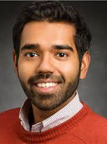

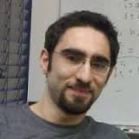
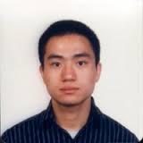
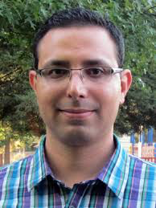
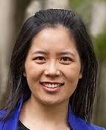
Relaxations of AC OPF
dealing with nonconvexity
Bose (UIUC)
Chandy
Farivar (Google)
Gan (FB)
Lavaei (UCB)
Li (Harvard)
many others at & outside Caltech …
Low, Convex relaxation of OPF, 2014
http://netlab.caltech.edu

Slide 7
Optimal power flow (OPF)
Computational challenge
OPF underlies numerous power system applications but is nonconvex (and NP-hard)
Scalability challenge
Future smart grid will have billions of intelligent distributed energy resources (DERs)
Our approach
Computation: developed relaxation theory that exploits hidden convexity structure
Scalability: developed distributed algorithms implementable by DERs based on relaxation

Slide 8
Optimal power flow (OPF)
min generation cost, network loss
generation limits
voltage constraints
power flow equations:
describes network topology and impedances
is net power injection (generation) at node j
“power balance at each node j” (Kirchhoff’s law)

Slide 9
Optimal power flow (OPF)
min generation cost, network loss
generation limits
voltage constraints
nonconvex feasible set
not Hermitian (nor positive semidefinite)
is positive semidefinite (and Hermitian)
nonconvex QCQP
[Ian Hiskens]

Slide 10
Equivalent feasible sets
quadratic in V
linear in W
Equivalent problem:
convex in W
except this constraint

Slide 11
Solution strategy
If optimal solution satisfies easily checkable conditions, then optimal solution of OPF can be recovered

Slide 12
Equivalent relaxations
Theorem
Radial G: SOCP is equivalent to SDP ( )
Mesh G: SOCP is strictly coarser than SDP
For radial networks: always solve SOCP !

Slide 13
Exact relaxation
For radial networks, sufficient conditions on
power injections bounds, or
voltage upper bounds, or
phase angle bounds

Slide 14
Exact relaxation
For radial networks, sufficient conditions on
power injections bounds, or
voltage upper bounds, or
phase angle bounds

Slide 15
Exact relaxation
QCQP
graph of QCQP
QCQP over tree

Slide 16
Exact relaxation
QCQP
Key condition
Theorem
SOCP relaxation is exact for
QCQP over tree
Bose et al 2012, 2014
Sojoudi, Lavaei 2013

Slide 17
Implication on OPF
Not both lower & upper bounds on real & reactive powers at both ends
of a line can be finite

Slide 18
Example
Real Power
Reactive Power
SOCP Y
SDP Y
power flow
solution X
Relaxation is exact if X and Y have same Pareto front
SOCP is faster but coarser than SDP
Bose, Low, Teeraratkul, Hassibi TAC 2015

Slide 19
Potential benefits
IEEE test
systems
SDP
cost
MATPOWER cost
12.4% lower cost than solution from nonlinear solver MATPOWER
[Louca, Seiler, Bitar 2013]

Slide 20
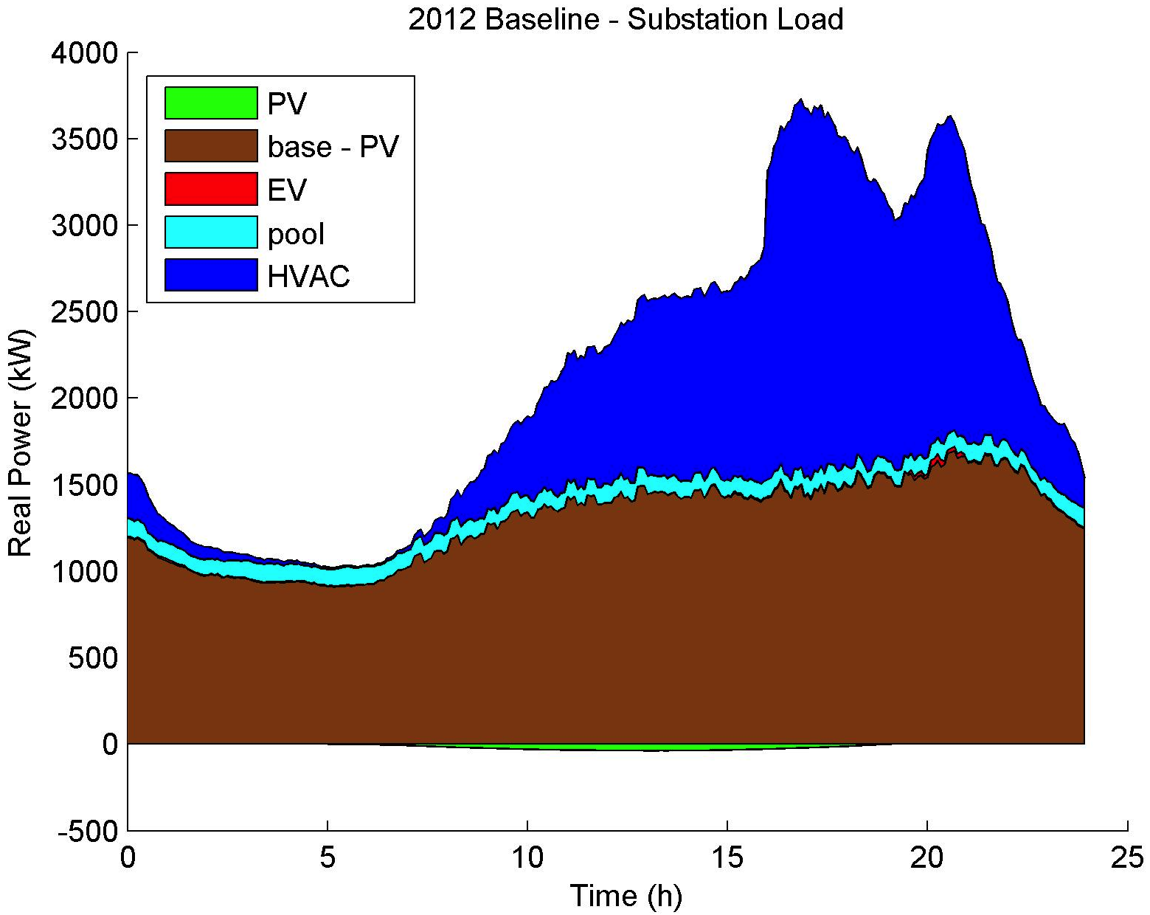
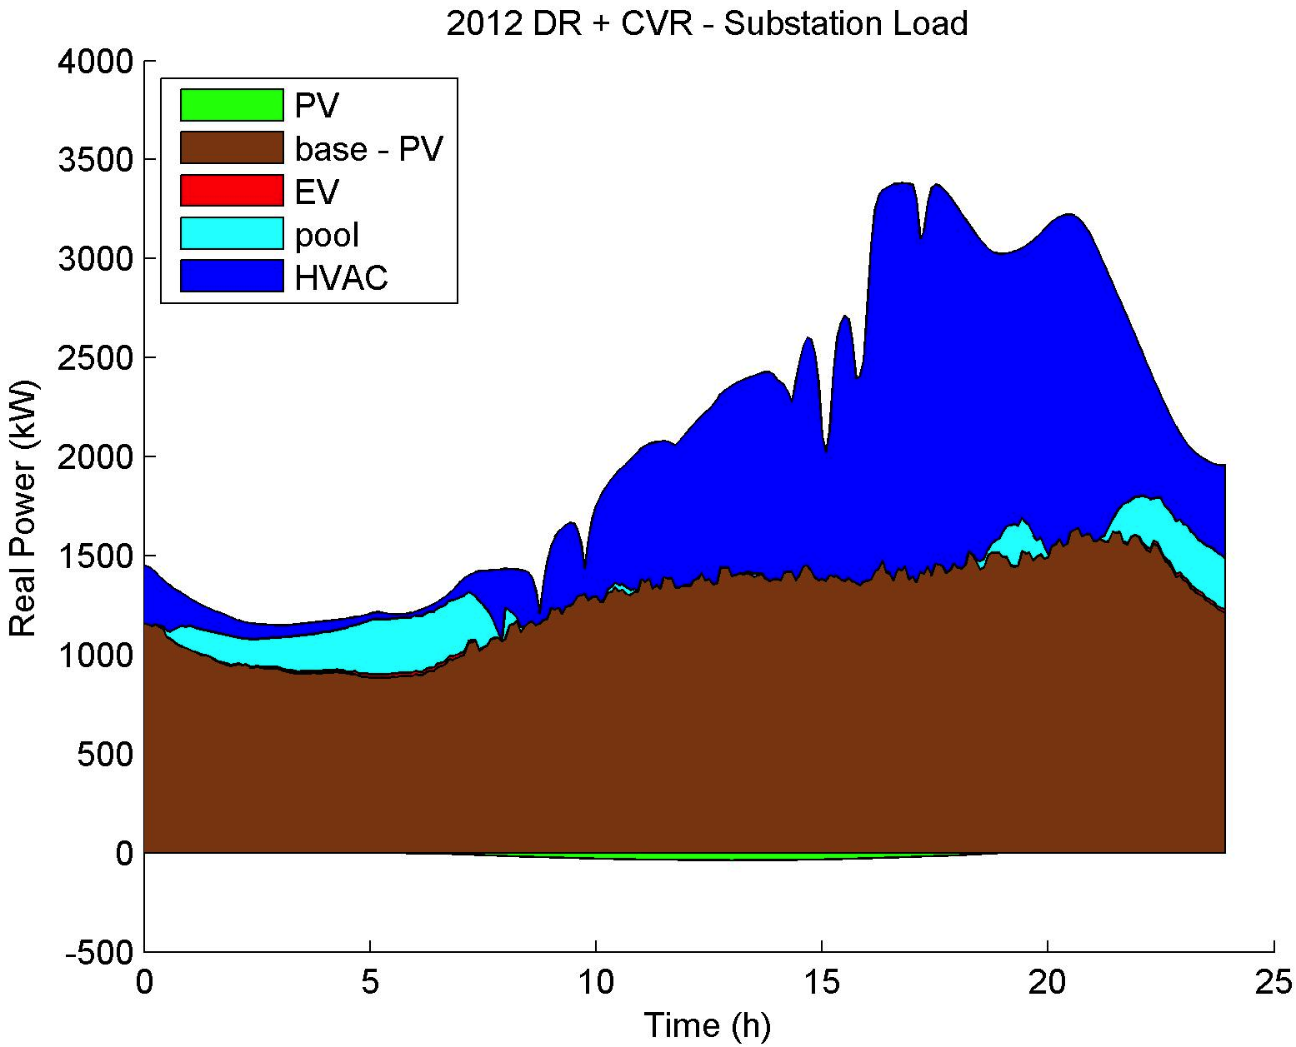
Potential benefits
Our research
Computation: developed relaxation theory that exploits hidden convexity structure
Scalability: developed distributed algorithms implementable by DERs based on relaxation theory
Benefits: captures values to both utility and users
baseline
optimized
peak load reduction: 8%
energy cost reduction: 4%

Slide 21
Convex relaxations of OPF
Kim, Baldick 1997
Dall’Anese et al 2012
Lam et al 2012
Kraning et al 2013
Devane, Lestas 2013
Sun et al 2013
Li et al 2013
Peng, Low 2014
applications
Phan 2012
Gopalakrishnan 2012
Louca et al 2013
Hijazi et al 2013
Andy Sun 2016
B&B,
rank min,
QC relaxation,
distributed
OPF
semidefinite relaxations
multiphase
unbalanced
exactness
moment/SoS,
based
relaxation
Dall’Anese et al 2012
Gan, Low 2014
ext refs in tutorial:
Low, TCNS 2014
http://netlab.caltech.edu
Molzahn, Hiskens 2014
Josz et al 2014
Ghaddar et al 2014

Slide 22
Challenges
Challenges for practical application
Relaxation may not be exact
Practical application demands a feasible solution
No known sufficient condition for exact relaxation for general mesh (transmission) networks
Semidefinite relaxation (as is) is not scalable

Slide 23
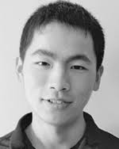
Distributed AC OPF
for scalability
Gan (FB)
Peng (Google)
Gan & L, PSCC 2014
Peng & L, TSG 2017

Slide 24
Summary: 3 ideas
1. Solve semidefinite relaxation using branch-flow model (BFM)
BFM much more numerically stable
assume relaxation is exact (radial nk)
2. Decouple into operations at each bus
introduce decoupling variables and consensus constraints
message passing between neighboring buses
3. Apply ADMM
derive closed-form solution or 6x6 eigenvalue problem for each ADMM subproblem
greatly speeds up each ADMM iteration

Slide 25
Summary: simulations
numerically
unstable
numerically
stable
BFM is much more numerically stable
SDP relaxations are exact (wye loads)
[Gan & Low 2014 PSCC]

Slide 26
Summary: comparison (single phase)
Network size N | Total Time S | Avg time ( = S/N ) | Centralized (CPU) | Centralized (elapsed)
IEEE 123 buses | 39.5 sec | 0.32 sec | 1.18 sec | 11.4 sec
Rossi 2,065 | 1,153 | 0.56 | 14.38 | 157.3
1,313 | 471 | 0.36 | 8.88 | 91.2
792 | 226 | 0.29 | 5.13 | 50.3
363 | 66 | 0.18 | 3.08 | 24.5
108 | 16 | 0.14 | 0.78 | 6.5
Parallel implementation of our distributed algorithm is much faster than solving OPF centrally
footnote: “Centralized” times reported by CVS in Matlab
Solving SOCP using CVX (not ADMM)
“CPU” time excludes problem set up before calling convex solver
“elapsed” time includes setup time in CVX

Slide 27
Summary: simulations
Network (unbalanced)
IEEE 13, 34, 37, 123 bus systems
Objective
loss minimization
Convergence time (computation only)
Network | Diameter | Iterations | Total Time | Avg Time
13 Bus | 6 | 289 | 17.11 | 1.32
34 Bus | 20 | 547 | 78.34 | 2.30
37 Bus | 16 | 440 | 75.67 | 2.05
123 Bus | 30 | 608 | 306.3 | 2.49

Slide 28
Details: 3 ideas
1. Solve semidefinite relaxation using branch-flow model (BFM)
BFM much more numerically stable
assume relaxation is exact (radial nk)
2. Decouple into operations at each bus
introduce decoupling variables and consensus constraints
message passing between neighboring buses
3. Apply ADMM
derive closed-form solution or 6x6 eigenvalue problem for each ADMM subproblem
greatly speeds up each ADMM iteration

Slide 29
BFM and relaxations
DistFlow model (Baran & Wu 1989)
nonconvex !
OPF
SOCP relaxation (Farivar & Low 2013)
Equivalent re-formulation of DistFlow equations (linear + quadratic term)
SOCP relaxation is often exact, yielding global optimal
Much more numerically stable than bus injection model
Notes:
In particular, we focus on convex relaxation of OPF in distribution networks, which is becoming more and more important at this time of massive integration of distributed energy resources, such renewables, flexible loads, and storage.
Distribution networks are typically radial, which means they have a tree topology that is simpler to analyze than mesh networks. Also, distribution networks have multiple, usually three phases, with unbalanced loads, and therefore cannot be accurately modeled by a simpler, single phase equivalent as is the case with transmission networks.
Recently there have been a few studies on the modeling, formulation, and convex relaxation of OPF in multiphase radial networks. All these studies take the phase-to-ground power injections as optimization variables, which essentially assumes that all the loads and generation resources are wye connected with grounded neutral, whereas in practice a lot of distribution networks are composed of mixed wye and delta connections. How to incorporate delta connections in convex relaxation of OPF is something that has not been studied before, and this is exactly what we do in this work.
(3:00)

Slide 30
BFM and relaxations
DistFlow model (Baran & Wu 1989)
But DistFlow model is single-phase !
How to generalize to 3-phase unbalanced system?
Preserve simple analytical structure of 1-phase model
Preserve superior numerical stability of 1-phase model
Notes:
In particular, we focus on convex relaxation of OPF in distribution networks, which is becoming more and more important at this time of massive integration of distributed energy resources, such renewables, flexible loads, and storage.
Distribution networks are typically radial, which means they have a tree topology that is simpler to analyze than mesh networks. Also, distribution networks have multiple, usually three phases, with unbalanced loads, and therefore cannot be accurately modeled by a simpler, single phase equivalent as is the case with transmission networks.
Recently there have been a few studies on the modeling, formulation, and convex relaxation of OPF in multiphase radial networks. All these studies take the phase-to-ground power injections as optimization variables, which essentially assumes that all the loads and generation resources are wye connected with grounded neutral, whereas in practice a lot of distribution networks are composed of mixed wye and delta connections. How to incorporate delta connections in convex relaxation of OPF is something that has not been studied before, and this is exactly what we do in this work.
(3:00)

Slide 31
Multiphase generalization
DistFlow model
for 1-phase
equivalent
re-formulation
SOCP
relaxation
distributed
solution
generalization
to 3-phase
SDP
relaxation
distributed
solution
radial, multiphase, wye + delta
Peng & Low 2017 TSG
Peng & Low 2015 CDC
Dall’Anese et al 2013 TSG
Gan & Low 2014 PSCC (above approach)
Zhao et al 2017 IREP
Notes:
In particular, we focus on convex relaxation of OPF in distribution networks, which is becoming more and more important at this time of massive integration of distributed energy resources, such renewables, flexible loads, and storage.
Distribution networks are typically radial, which means they have a tree topology that is simpler to analyze than mesh networks. Also, distribution networks have multiple, usually three phases, with unbalanced loads, and therefore cannot be accurately modeled by a simpler, single phase equivalent as is the case with transmission networks.
Recently there have been a few studies on the modeling, formulation, and convex relaxation of OPF in multiphase radial networks. All these studies take the phase-to-ground power injections as optimization variables, which essentially assumes that all the loads and generation resources are wye connected with grounded neutral, whereas in practice a lot of distribution networks are composed of mixed wye and delta connections. How to incorporate delta connections in convex relaxation of OPF is something that has not been studied before, and this is exactly what we do in this work.
(3:00)

Slide 32
3phase model
3-phase balanced
(positive sequence)
per-phase analysis
3-phase unbalanced
(phase frame)
3-phase analysis
3x3 matrix

Slide 33
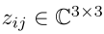
BFM: 3phase (wye)
Auxiliary variables:
Ohm’s law:
Power balance:
3x3 rank-1 matrices
Notes:
Now we look at the extension this framework to a multiphase network with wye connections only.
The notation is similar to the single-phase case except that everyone is expanded to three phases with superscripts a, b, and c. The net load s_Y,i with subscript Y emphasizes that it is wye connected with grounded neutral. The impedance z_ij is now a 3 by 3 complex matrix.
The equations for the multiphase branch flow model also look quite similar to the single phase case. But here are the differences. This V_i and I_ij are both 3-dimensional column vectors that collect their a, b, c components, and this superscript H denotes conjugate transpose. Therefore v_i, S_ij, and ell_ij are each three by three blocks. In particular, the diagonal terms of v_i are the voltage magnitude squares of phases a, b, c at bus i. The diagonal of ell_ij are the three-phase current magnitude squares on line ij, and the diagonal of S_ij are the thee-phase sending-end power from i to j.
Ohm’s law, same as before, can be written in terms of small v, S, and ell. Power balance equation is now three dimensional, with wye-connected net load s_Y,i on the RHS.

Slide 34
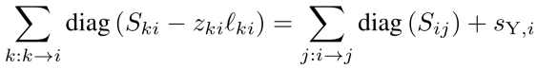
BFM: 3phase (wye)
Auxiliary variables:
Ohm’s law:
Power balance:
6x6 matrix
3x3 matrices
3-vectors (a,b,c)
Notes:
Now we look at the extension this framework to a multiphase network with wye connections only.
The notation is similar to the single-phase case except that everyone is expanded to three phases with superscripts a, b, and c. The net load s_Y,i with subscript Y emphasizes that it is wye connected with grounded neutral. The impedance z_ij is now a 3 by 3 complex matrix.
The equations for the multiphase branch flow model also look quite similar to the single phase case. But here are the differences. This V_i and I_ij are both 3-dimensional column vectors that collect their a, b, c components, and this superscript H denotes conjugate transpose. Therefore v_i, S_ij, and ell_ij are each three by three blocks. In particular, the diagonal terms of v_i are the voltage magnitude squares of phases a, b, c at bus i. The diagonal of ell_ij are the three-phase current magnitude squares on line ij, and the diagonal of S_ij are the thee-phase sending-end power from i to j.
Ohm’s law, same as before, can be written in terms of small v, S, and ell. Power balance equation is now three dimensional, with wye-connected net load s_Y,i on the RHS.

Slide 35
BFM: 3phase (wye)
Auxiliary variables:
Ohm’s law:
Power balance:
equivalent to
DistFlow
equations
if single-phase
Notes:
Now we look at the extension this framework to a multiphase network with wye connections only.
The notation is similar to the single-phase case except that everyone is expanded to three phases with superscripts a, b, and c. The net load s_Y,i with subscript Y emphasizes that it is wye connected with grounded neutral. The impedance z_ij is now a 3 by 3 complex matrix.
The equations for the multiphase branch flow model also look quite similar to the single phase case. But here are the differences. This V_i and I_ij are both 3-dimensional column vectors that collect their a, b, c components, and this superscript H denotes conjugate transpose. Therefore v_i, S_ij, and ell_ij are each three by three blocks. In particular, the diagonal terms of v_i are the voltage magnitude squares of phases a, b, c at bus i. The diagonal of ell_ij are the three-phase current magnitude squares on line ij, and the diagonal of S_ij are the thee-phase sending-end power from i to j.
Ohm’s law, same as before, can be written in terms of small v, S, and ell. Power balance equation is now three dimensional, with wye-connected net load s_Y,i on the RHS.

Slide 36
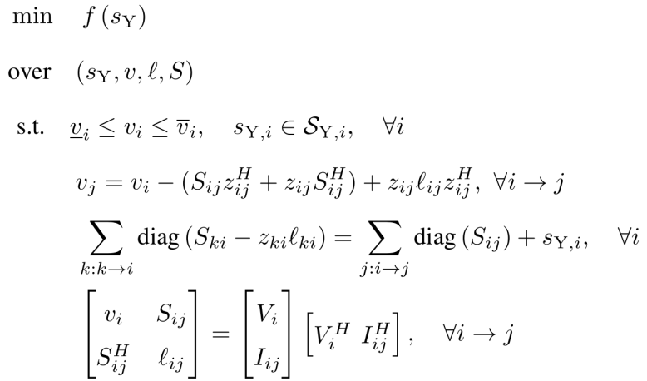
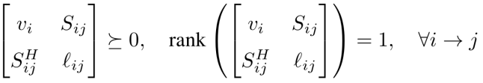
OPF (3phase, wye)
branch flow model
non-convex
Notes:
OPF formulation is not much different from the single-phase case. Now the optimization variable is s_Y.
There is a typo here: it should be diagonal terms of v_i that are the voltage magnitude squares subject to the voltage regulation constraint. Again, to express everything in v, ell, and S, we replace the last constraint with semidefinite and rank one constraints, where the rank one constraint is non-convex.

Slide 37
SDP relaxation (3phase, wye)
branch flow model
6x6: semidefinite constraint
Gan, Low 2014 PSCC
Notes:
Removing it leads to a convex relaxation of OPF. With this semidefinite constraint on a 6 times 6 matrix, this relaxed convex problem is a semidefinite program (SDP).

Slide 38
Partition & decouple
decoupling vars
power balance & voltage eqtns
PSD & injection constraints
voltage magnitude constraints
consensus constraints
(coupling across i)

Slide 39
ADMM
: Lagrangian multiplier for coupling constraint
augmented Lagrangian:
ADMM update at each iteration k
reduce min to
QP: closed-form soln
SDP: 6x6 eigenvalue
problems
[Peng & L, 2016]

Slide 40
ADMM
Greatly speeds up each ADMM iteration
much faster than standard iterative solution for each ADMM subproblem
per-bus computation time | x-update | z-update
Our algorithm | 1.7 x 10⁻⁴ sec | 5.1 x 10⁻⁴ sec
CVX | 2 x 10⁻¹ sec | 3 x 10⁻¹ sec
speedup | 1,176x | 588x
per-bus computation time : time to solve 1 sample ADMM iteration for Rossi circuit
with 2,065 buses, divided by 2,065, for both algorithms (single-phase)

Slide 41
Challenges
Challenges for practical application
ADMM too slow for high precision solution
Relaxation (feasible power flow)
Wye loads: empirically exact but no proof
Delta loads: empirically inexact
Offline (distributed) algorithm
Intermediate iterates are not feasible and cannot be applied to network

Slide 42
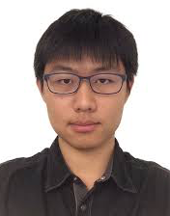
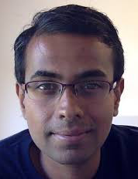
Realtime AC OPF
for tracking
Gan (FB)
Tang (Caltech)
Dvijotham (DeepMind)
See also: Dall’Anese et al, Bernstein et al,
Hug & Dorfler et al, Callaway et al
Gan & L, JSAC 2016
Tang et al, TSG 2017

Slide 43
OPF
power flow equations
operational constraints
controllable
devices
uncontrollable
state
capacity limits

Slide 44
OPF
power flow equations
operational constraints
capacity limits

Slide 45
OPF
power flow equations
operational constraints
capacity limits

Slide 46
Static OPF
gradient projection algorithm:
active control
law of physics
[Gan & Low, JSAC 2016]

Slide 47
Online (feedback) perspective
cyber
network
measurement,
communication
y(t)
control
x(t)
physical
network
Explicitly exploits network as power flow solver
Naturally tracks changing network conditions

Slide 48
Drifting OPF
static
OPF
drifting
OPF

Slide 49
Drifting OPF
Quasi-Newton algorithm:
active control
law of physics
[Tang, Dj & Low, 2017]

Slide 50
Tracking performance
control error
Theorem
avg rate of drifting

Slide 51
Tracking performance
Theorem
avg rate of drifting
of optimal solution
of feasible injections

Slide 52
Tracking performance
Theorem
error in Hessian approx

Slide 53
Tracking performance
Theorem
“condition number” of Hessian

Slide 54
Tracking performance
Theorem
“initial distance” from

Slide 55
Implementation
Implement L-BFGS-B
More scalable
Handles (box) constraints X
Simulations
IEEE 300 bus

Slide 56
Tracking performance
IEEE 300 bus

Slide 57
Tracking performance
IEEE 300 bus

Slide 58
Key message
Large network of DERs
Real-time optimization at scale
Computational challenge: power flow solution
Online optimization [feedback control]
Network computes power flow solutions in real time at scale for free
Exploit it for our optimization/control
Naturally adapts to evolving network conditions
Examples
Slow timescale: OPF
Fast timescale: frequency control

Slide 59
Challenges
Challenges for practical application
Distributed implementation
Tracking with lower update speed
Not all buses have sensors/controllers

Slide 60
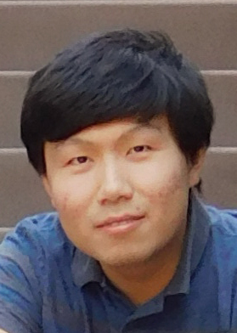
Optimal placement
dealing with limited sensing/control
Guo (Caltech)
Guo & Low CDC 2017

Slide 61
Summary
Characterization of controllability and observability
of swing dynamics
in terms spectrum of graph Laplacian matrix
Implications on optimal placement of controllable DERs and sensors
set covering problem

Slide 62
Network model
swing dynamics:
controllable DER
frequency sensor
weighted Laplacian matrix

Slide 63
Algebraic coverage
spectral decomposition of L
eigenvectors of L
algebraic coverage of bus j

Slide 64
Controllability
Theorem
Swing dynamics is controllable if and only if
L has a simple spectrum
controllable DERs have full coverage
holds a.s.

Slide 65
Observability
Theorem
Swing dynamics is observable if and only if
L has a simple spectrum
frequency sensors have full coverage
holds a.s.

Slide 66
Application
Optimal placement of DER & frequency sensors
set covering problem
always install sensors at buses with controllable DERs, and vice versa

Slide 67
Application
without control
IEEE 39-bus New England system
nominal frequency restored
1pu step disturbance at bus 30
with local control at single bus 35

Slide 68
Summary
Relaxations of AC OPF
Dealing with nonconvexity
Distributed AC OPF
Dealing with scalability
Realtime AC OPF
Dealing with volatility
Optimal placement
Dealing with limited sensing/control

